Slide 2
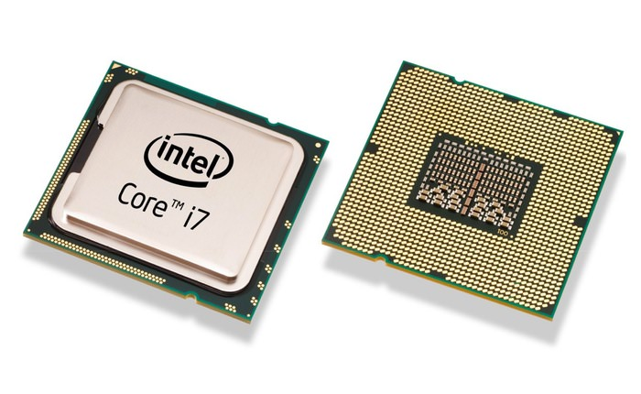
2.2 Threads

Slide 3
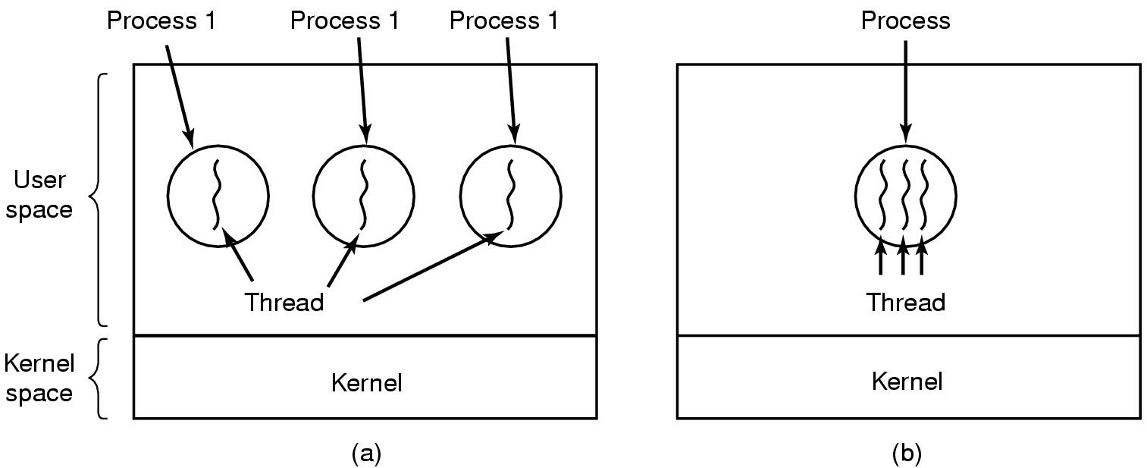
Threads The Thread Model
(a) Three processes each with one thread
(b) One process with three threads

Slide 4
Threads Process with single thread
A process:
Address space (text section, data section)
Single thread of execution
program counter
registers
Stack
Other resource (open files, child processes…)

Slide 5
Threads Process with multiple threads
Multiple threads of execution in the same
environment of process
Address space (text section, data section)
Multiple threads of execution, each thread has private set:
program counter
registers
stack
Other resource (open files, child processes…)

Slide 6
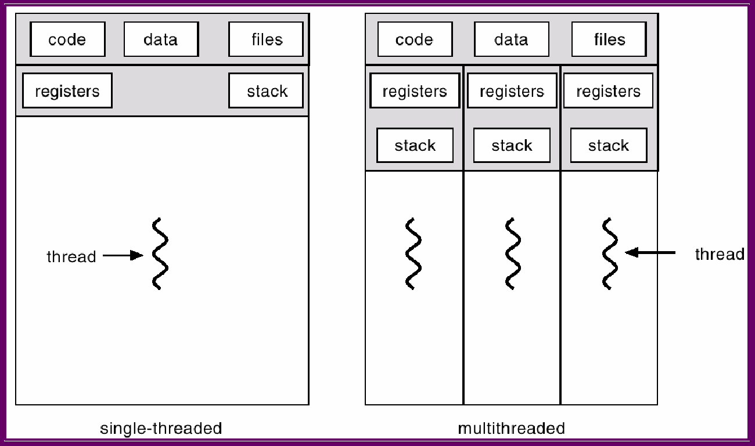
Threads Single and Multithreaded Processes
A thread refers to the execution of an entire process from start to finish without being interrupted by a thread while multithreading refers to allowing multiple threads in a process so that they are executed independently while splitting. share their resources
PC
PC
PC
PC
Notes:
Sự khác nhau giữa luồng đơn và đa luồng: Một luồng đề cập đến việc thực thi toàn bộ quy trình từ đầu đến cuối mà không bị gián đoạn bởi một luồng trong khi đa luồng đề cập đến việc cho phép nhiều luồng trong một quy trình để chúng được thực thi độc lập trong khi chia sẻ tài nguyên của chúng.

Slide 7
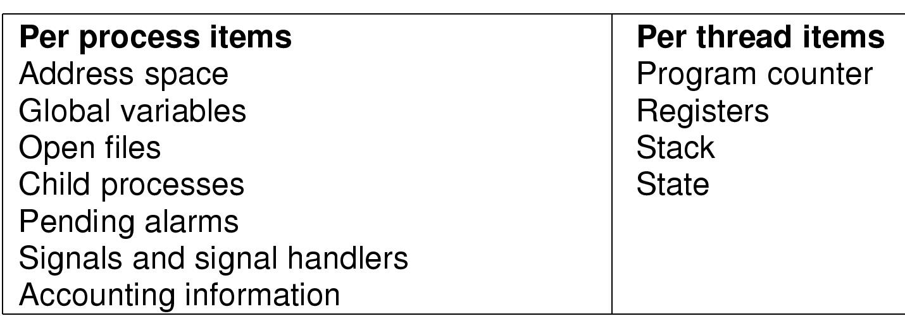
Threads Items shared and Items private
Items shared by all threads in a process
Items private to each thread

Slide 8
Threads Benefits
Responsiveness: Multithread makes interactive applications work better because even if a part of the program is blocked or takes a long time to function, the program can generally run.
Resource Sharing: Processes can only share data through techniques such as shared memory and message sharing.
Economy: It is very expensive to provide resources and data to the process.
Utilization of Multiprocessor Architectures: multithread helps threads work in parallel in different processor cores, while for single-threaded process a thread can run on only one processor, no matter how many threads there are in the system. present.

Slide 9
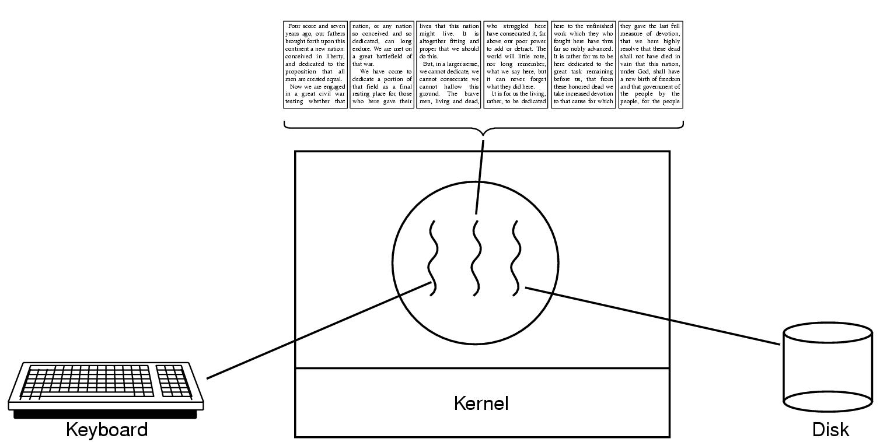
Threads Thread Usage (1)
The first thread just interacts with the user.
The second thread reformats the document when told to.
The third thread writes the contents of RAM to disk periodically.
A word processor with three threads

Slide 10
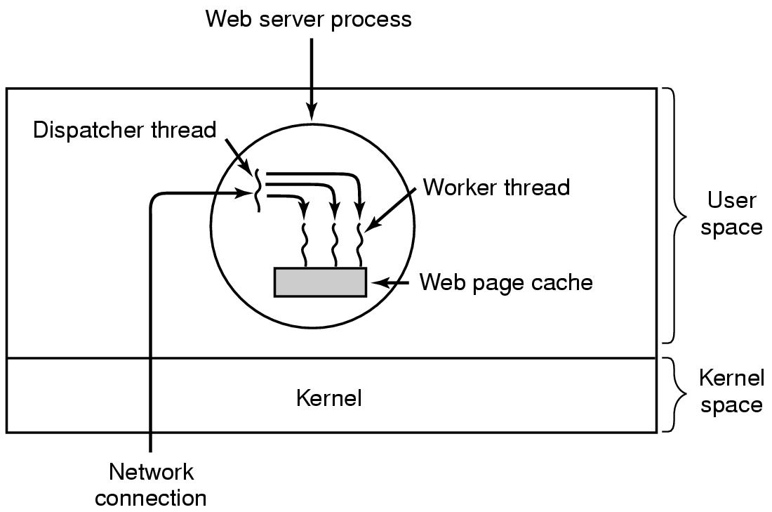
Threads Thread Usage (2)
Each worker's code consists of:
an infinite loop consisting of accepting a request from the dispatcher
checking the Web cache to see if the page is present.
It is returned to the client and the worker blocks waiting for a new request.
A multithreaded Web server

Slide 11
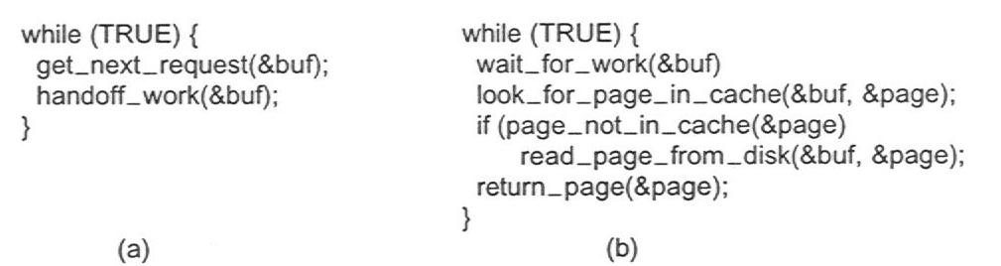
Threads Thread Usage (3)
Rough outline of code for previous slide
(a) Dispatcher thread
(b) Worker thread

Slide 12
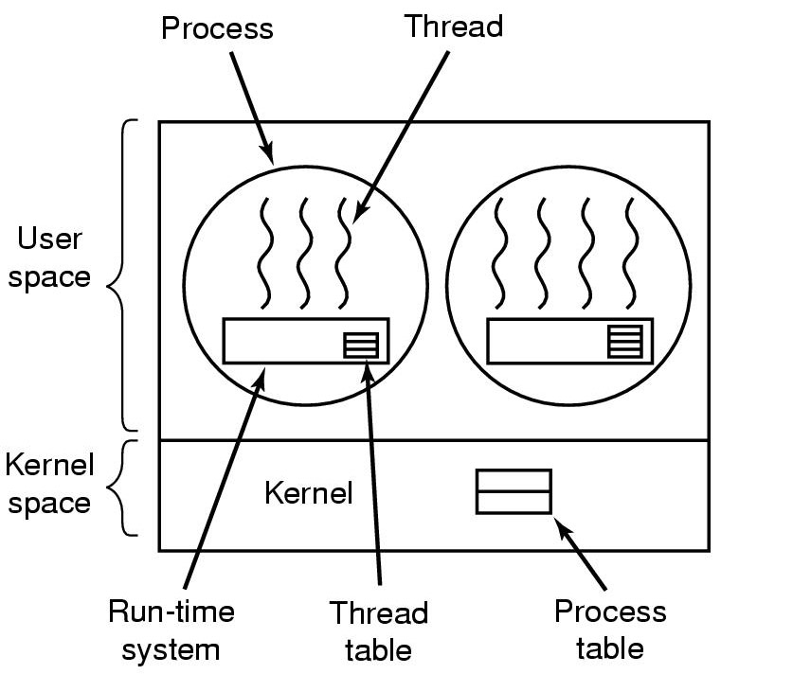
Threads Implementing Threads in User Space (1)
This type of thread is loaded entirely in user space, the kernel knows nothing about them.
When threads are managed in user space, each process needs its own thread table
the thread table includes the program counter, stack pointer, registers, state, etc.
A user-level threads package

Slide 13
Threads Implementing Threads in User Space (2)
Thread library, (run-time system) in user space
thread_create
thread_exit
thread_wait
thread_yield (to voluntarily give up the CPU)
Thread control block (TCB) ( Thread Table) stores states of user thread (program counter, registers, stack)
Kernel does not know the present of user thread

Slide 14
Threads Implementing Threads in User Space (3)
Traditional OS provide only one “kernel thread” presented by PCB for each process.
Blocking problem: If one user thread is blocked ->the kernel thread is blocked, -> all other threads in process are blocked.
user
thread
u
u
u
u
u
u
u
u
u
thread library
thread library
thread library
PCB
PCB
PCB
kernel

Slide 15
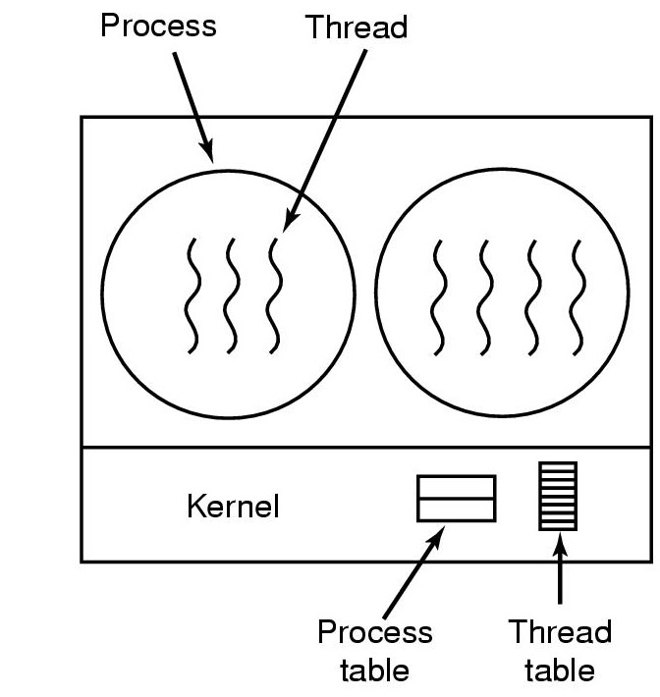
Threads Implementing Threads in the Kernel (1)
In kernel-level threads:
the kernel does all the work of thread movement.
The kernel has a thread table that keeps track of all the threads in the system.
When a thread wants to create a new thread or destroy any existing thread, it makes a Kernel call, which performs this action.
A threads package managed by the kernel

Slide 16
Threads Implementing Threads in the Kernel (2)
Multithreading is directly supported by OS:
Kernel manages processes and threads
CPU scheduling for thread is performed in kernel
Advantage of multithreading in kernel
Is good for multiprocessor architecture
If one thread is blocked does not cause the other thread to be blocked.
Kernel can schedule multiple threads concurrently
Disadvantage of Multithreading in kernel
Creation and management of thread is slower

Slide 17
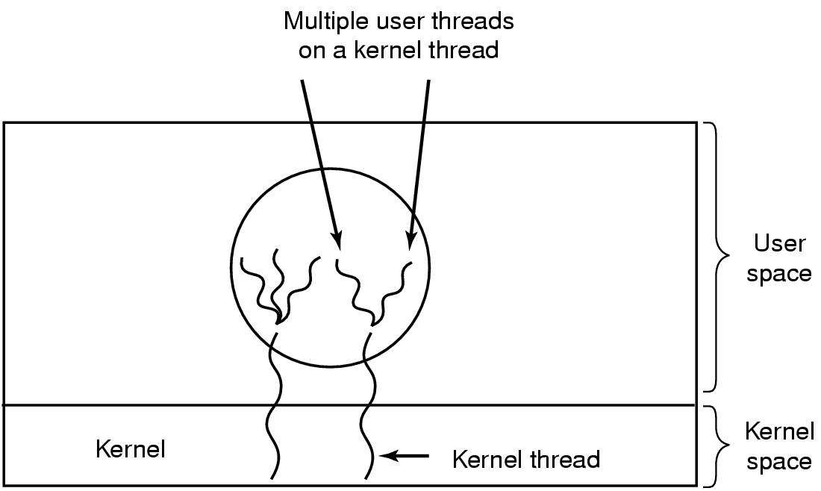
Threads Hybrid Implementations
- Various ways have been studied to try to combine the advantages of user-level threads with kernel-level threads.
- One way is to use kernel-level threads and then multiplex user-level threads into some or all of the kernel threads
Multiplexing user-level threads onto kernel- level threads

